Slide 1



Applications of AI in Internal Medicine
Amol Verma| MD MPhil FRCPC
Clinician-Scientist, St Michael's Hospital, Unity Health Toronto
Temerty Professor of AI Research and Education in Medicine, University of Toronto
Associate Professor, Department of Medicine, Department of Laboratory Medicine and Pathobiology, and Institute of Health Policy, Management and Evaluation, University of Toronto
Co-Lead GEMINI
Provincial Clinical Lead, Ontario Health

Slide 2
Disclosures
Minority interests in Signal1

Slide 3
What clinical capabilities of AI are relevant for Internal Medicine?

Slide 4
Ground Rules
Assess trajectory of improvement
No hype, only evidence
“Canadian” perspective
Capabilities based on widely-available technology and data (no robots)

Slide 5
Evaluation – Dr. Excellent Resident, PGY2
“It was a pleasure to work with Dr. Resident on this block. She has an outstanding knowledge base, demonstrated excellent communication skills with concise and accurate clinical documentation, had sound decision-making.”

Slide 6
Evaluation – Dr. Excellent Resident, PGY2
“It was a pleasure to work with Dr. Resident on this block. She has an outstanding knowledge base, demonstrated excellent communication skills with concise and accurate clinical documentation, had sound decision-making.”
Diagnose undifferentiated disease
Manage exacerbations of chronic illness
Treat acute, episodic illnesses
Coordinate care in the hospital

Slide 7
1. Knowledge Base

Slide 8

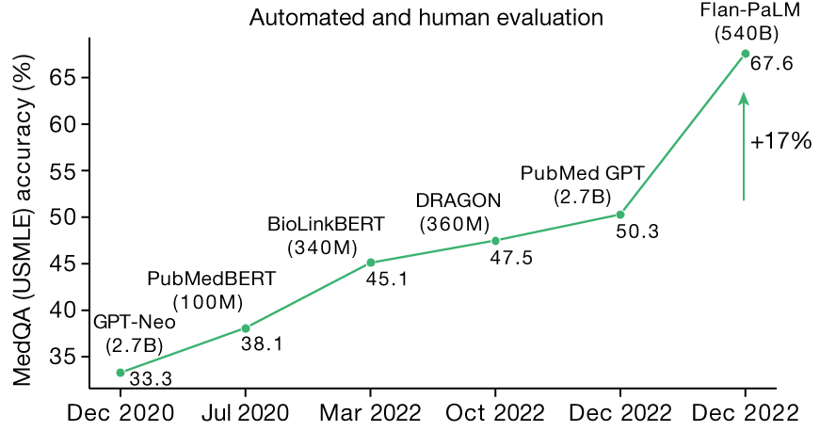

AI performance improving over time

Slide 9
AI performance improving over time
Is this “knowledge” or just questions seen in training?

Slide 10
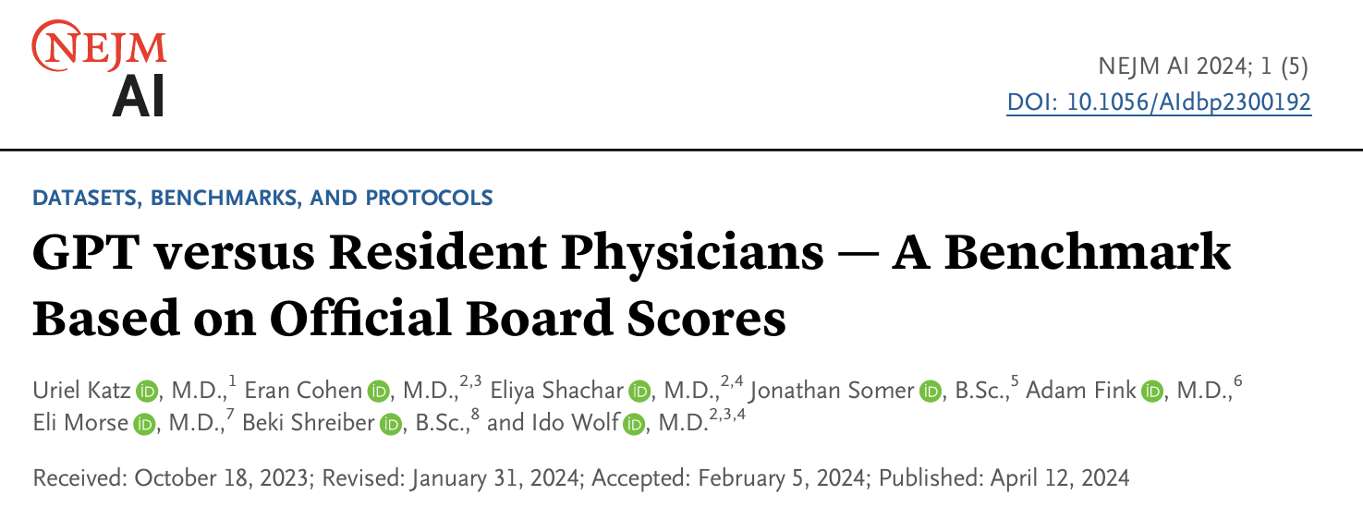
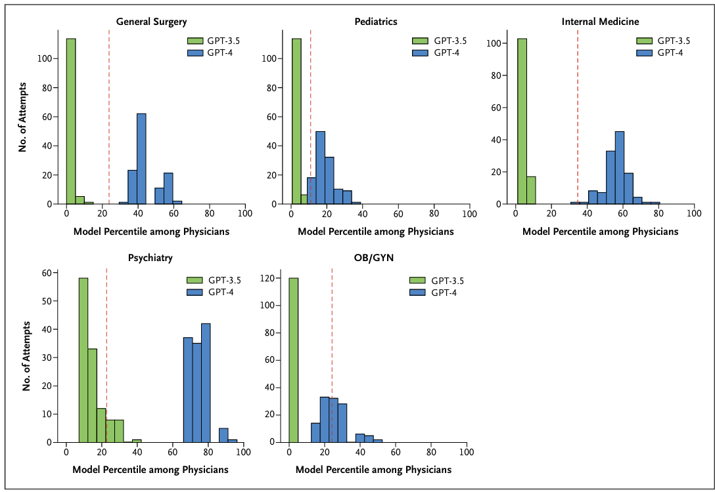
Israeli licencing exams
Notes:
Generative pretrained transformer (GPT) model percentiles among physicians on 120 attempts at the examination for every medical specialty are shown. The dotted red lines mark the percentile corresponding with a passing score. The graphic was created by the authors using data from the 2022 Israeli board residency examinations and results from the GPT models. OB/GYN denotes obstetrics and gynecology
To account for model variability between attempts, this procedure was repeated 120 times for each model across each medical specialty..

Slide 11
Passing
AI passes Israeli licencing exams
AI models pass Gen Surg, Int Med, Psych exams consistently. Perform less well on Paeds and OB-GYN
Notes:
Generative pretrained transformer (GPT) model percentiles among physicians on 120 attempts at the examination for every medical specialty are shown. The dotted red lines mark the percentile corresponding with a passing score. The graphic was created by the authors using data from the 2022 Israeli board residency examinations and results from the GPT models. OB/GYN denotes obstetrics and gynecology
To account for model variability between attempts, this procedure was repeated 120 times for each model across each medical specialty..

Slide 12
2. Clinical Documentation

Slide 13
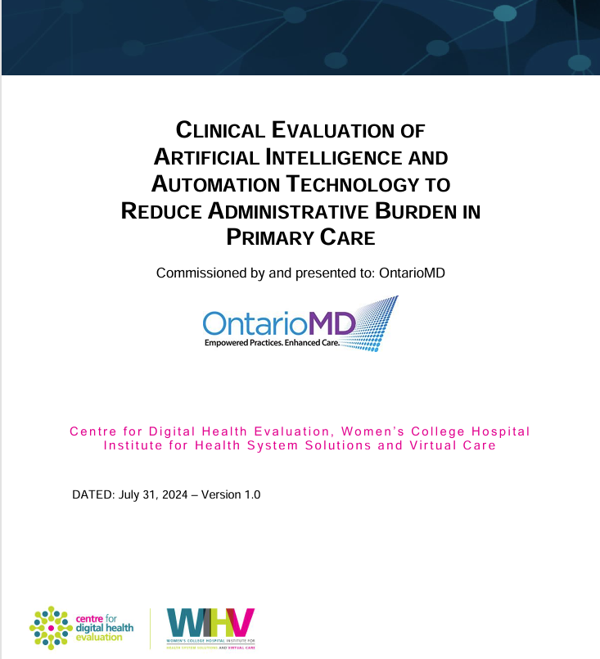
AI Scribes
~150 PCPs over 3 months, found reported 3 hrs saved per week on after-hours admin

Slide 14
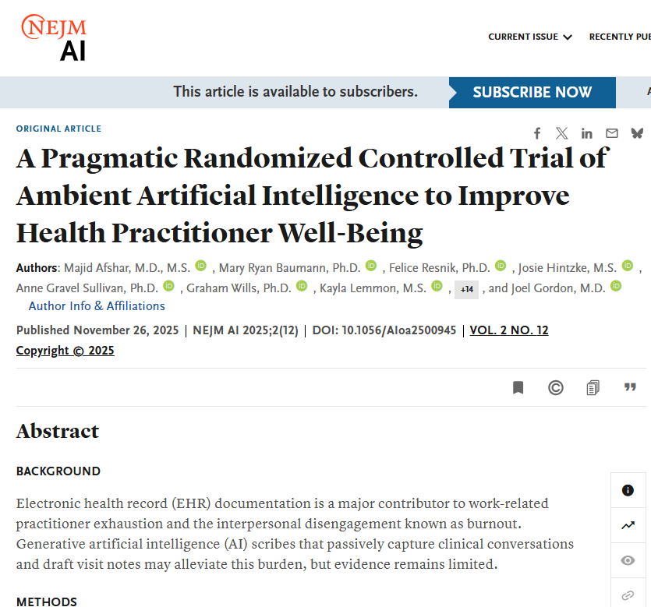
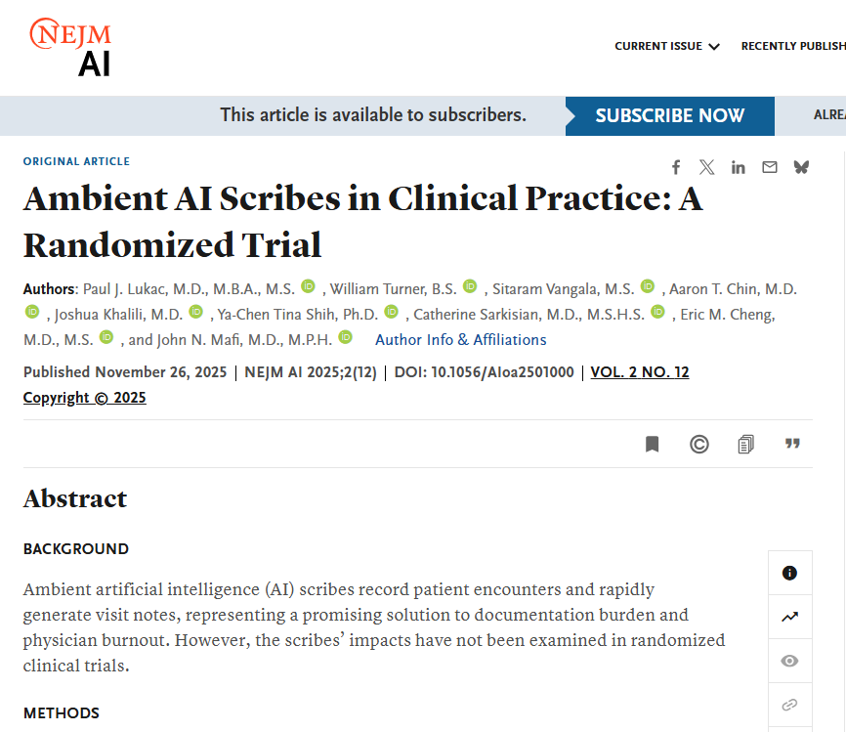
AI Scribes
66 outpatient practitioners
70% used scribe
Saved 0.36h per week
238 outpatient MDs randomized to DAX or Nabla
30% used scribe
DAX: no change in time-in-note
Nabla 10% decrease in time in note (41 seconds)
Inaccuracies noted “occasionally”
Both studies: Potential improvement in burnout, task load, exhaustion

Slide 15
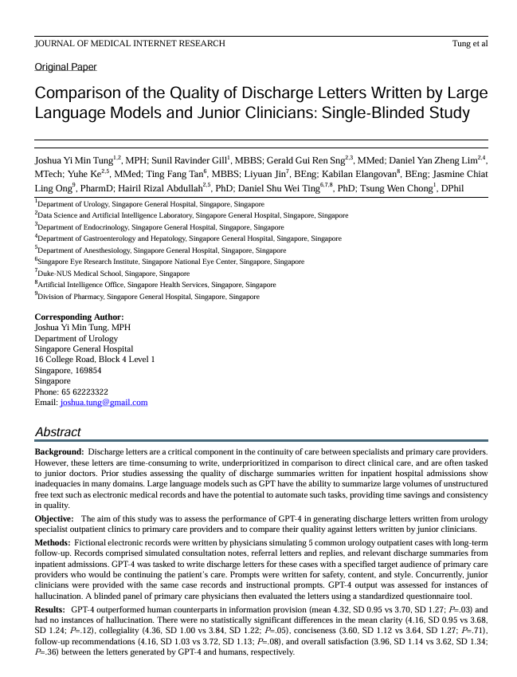
Gather History and Summarize Information From EHR
AI produced resident level discharge summaries in Urology clinics

Slide 16
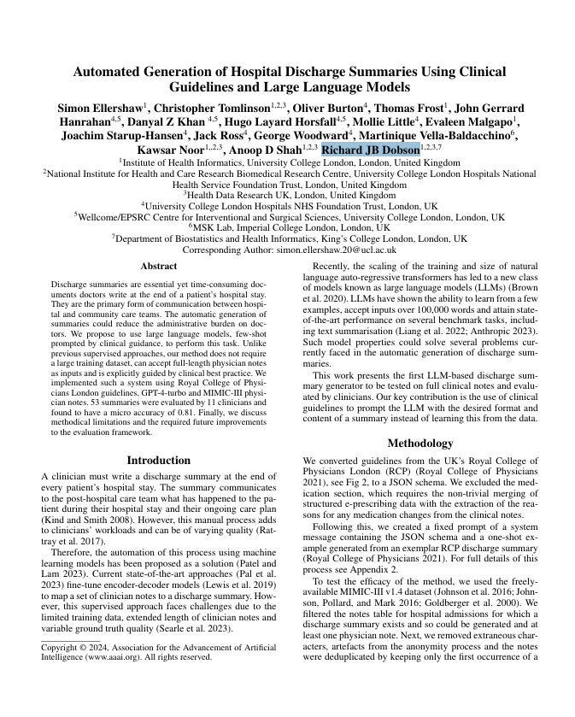
Gather History and Summarize Information From EHR
AI produced resident level discharge summaries in Urology clinics
AI produced hospital discharge summaries for ICU patients with ~80% accuracy on details but 14% hallucinations

Slide 17
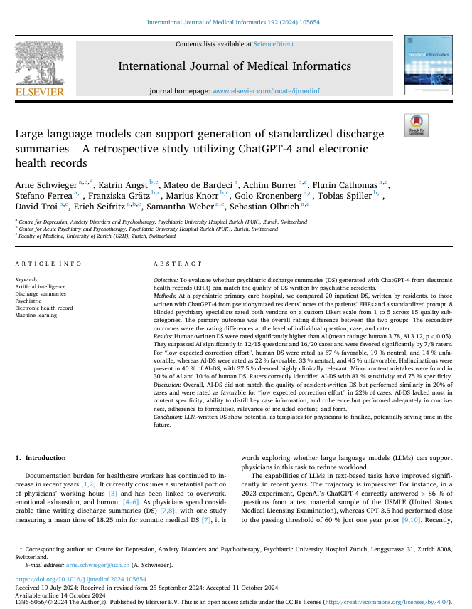
Gather History and Summarize Information From EHR
AI produced resident level discharge summaries in Urology clinics
AI produced hospital discharge summaries for ICU patients with ~80% accuracy on details but 14% hallucinations
On psychiatric discharge summaries 22% of AI summaries were ranked “favorable” (vs 67% of resident summaries) with 40% hallucinations

Slide 18
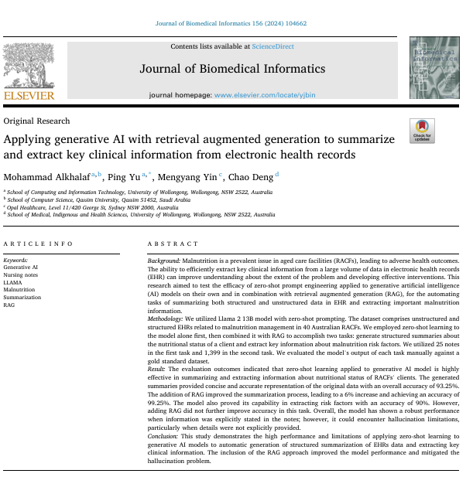
Gather History and Summarize Information From EHR
Adding “Retrieval Augmented Generation” (RAG) improved note accuracy to >90% with zero hallucinations

Slide 19
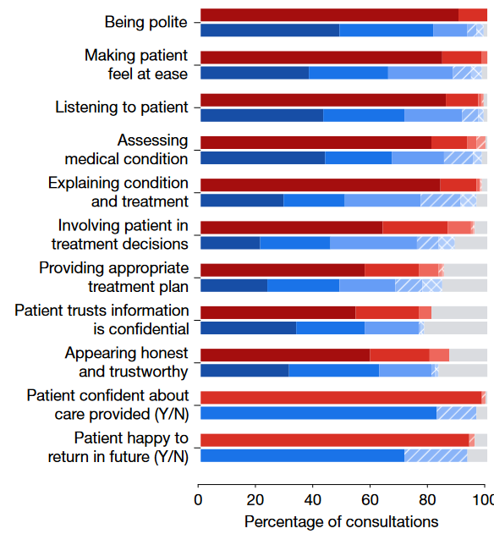
Gather History and Summarize Information From EHR
Google Research developed the “Articulate Medical Intelligence Explorer (AMIE)”.
Randomized study vs MDs in text-based consultations with patient actors.
Tu et al. Nature 2025

Slide 20
3. Diagnosis and decision-making

Slide 21
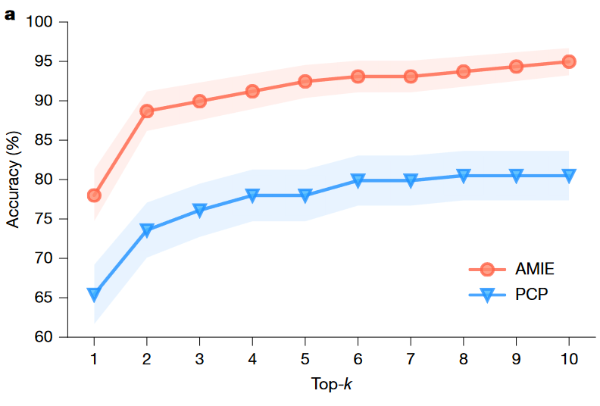
Diagnosis and Decision-making
Google Research developed the “Articulate Medical Intelligence Explorer (AMIE)”.
Randomized study vs MDs in text-based consultations with patient actors.
Tu et al. Nature 2025
Notes:
Better at eliciting history or better at synthesizing into a diagnosis?
Similar performance when AI used the MD chat
Caveat: synthetic environment

Slide 22
Clinical Knowledge and Capabilities of AI - Takeaways
Improving ability to encode “real” knowledge, not just questions seen in training data
Knowledge base is inconsistent across specialties
Able to synthesize and communicate medical information in natural language is improving, but still limited by accuracy
Improving and impressive performance in diagnostic tasks and decision-making

Slide 23
What can AI and Clinicians do together?

Slide 24
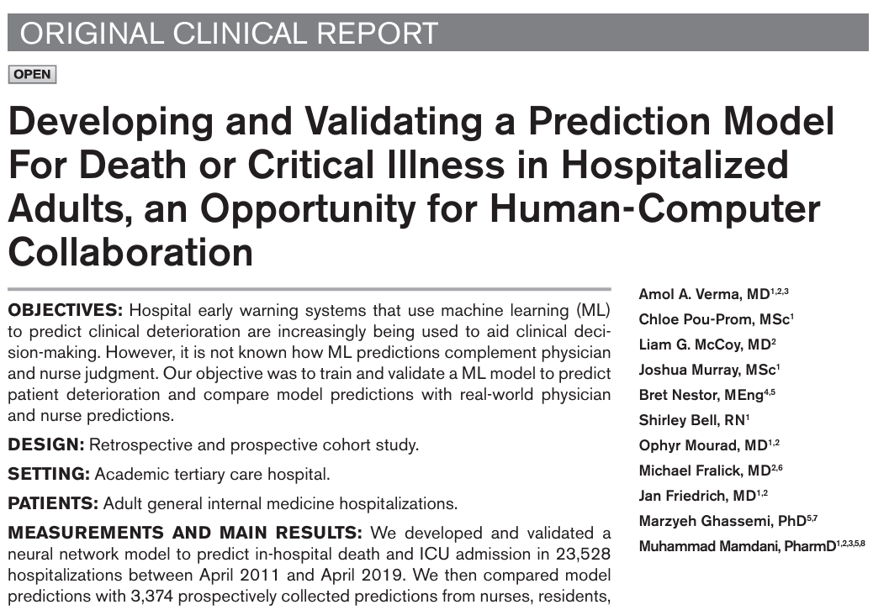
Combining clinician and AI predictions could improve detection of death or critical illness by 16% compared to clinicians alone

Slide 25
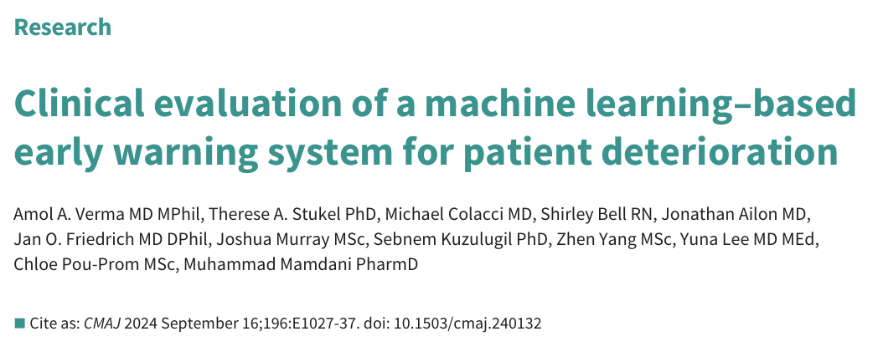
Combining clinician and AI predictions could improve detection of death or critical illness by 16% compared to clinicians alone
Implementing AI early warning system associated with 26% reduction in non-palliative mortality on GIM at an academic hospital

Slide 26
What can AI do that clinicians can’t?

Slide 27
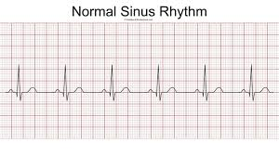
Notes:
We included 180 922 patients with 649 931 normal sinus rhythm ECGs for analysis: 454 789 ECGs recorded from 126 526 patients in the training dataset, 64 340 ECGs from 18 116 patients in the internal validation dataset, and 130 802 ECGs from 36 280 patients in the testing dataset. 3051 (8·4%) patients in the testing dataset had verified atrial fibrillation before the normal sinus rhythm ECG tested by the model. A single AI-enabled ECG identified atrial fibrillation with an AUC of 0·87 (95% CI 0·86–0·88), sensitivity of 79·0% (77·5–80·4), specificity of 79·5% (79·0–79·9), F1 score of 39·2% (38·1–40·3), and overall accuracy of 79·4% (79·0–79·9).
1003 patients with a mean age of 74 years (SD 8·8) from 40 US states completed the study. Over a mean 22·3 days of continuous monitoring, atrial fibrillation was detected in six (1·6%) of 370 patients with low risk and 48 (7·6%) of 633 with high risk (odds ratio 4·98, 95% CI 2·11–11·75, p=0·0002). Compared with usual care, AI-guided screening was associated with increased detection of atrial fibrillation (high-risk group: 3·6% [95% CI 2·3–5·4] with usual care vs 10·6% [8·3–13·2] with AI-guided screening, p<0·0001; low-risk group: 0·9% vs 2·4%, p=0·12) over a median follow-up of 9·9 months (IQR 7·1–11·0).

Slide 28
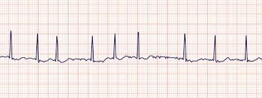
Atrial Fibrillation
Notes:
We included 180 922 patients with 649 931 normal sinus rhythm ECGs for analysis: 454 789 ECGs recorded from 126 526 patients in the training dataset, 64 340 ECGs from 18 116 patients in the internal validation dataset, and 130 802 ECGs from 36 280 patients in the testing dataset. 3051 (8·4%) patients in the testing dataset had verified atrial fibrillation before the normal sinus rhythm ECG tested by the model. A single AI-enabled ECG identified atrial fibrillation with an AUC of 0·87 (95% CI 0·86–0·88), sensitivity of 79·0% (77·5–80·4), specificity of 79·5% (79·0–79·9), F1 score of 39·2% (38·1–40·3), and overall accuracy of 79·4% (79·0–79·9).
1003 patients with a mean age of 74 years (SD 8·8) from 40 US states completed the study. Over a mean 22·3 days of continuous monitoring, atrial fibrillation was detected in six (1·6%) of 370 patients with low risk and 48 (7·6%) of 633 with high risk (odds ratio 4·98, 95% CI 2·11–11·75, p=0·0002). Compared with usual care, AI-guided screening was associated with increased detection of atrial fibrillation (high-risk group: 3·6% [95% CI 2·3–5·4] with usual care vs 10·6% [8·3–13·2] with AI-guided screening, p<0·0001; low-risk group: 0·9% vs 2·4%, p=0·12) over a median follow-up of 9·9 months (IQR 7·1–11·0).

Slide 29
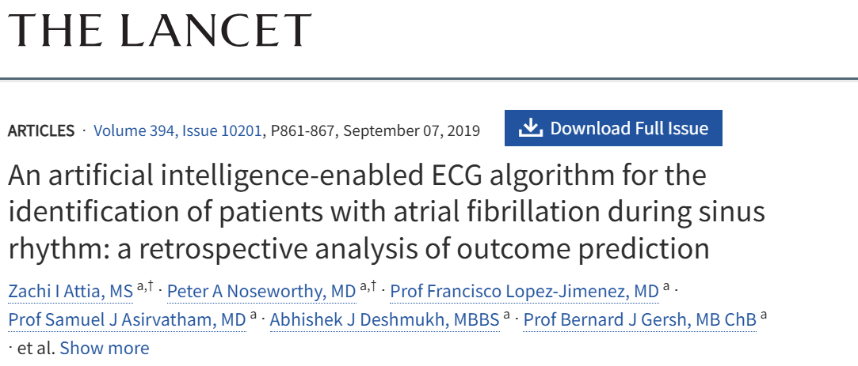
Atrial Fibrillation
Notes:
We included 180 922 patients with 649 931 normal sinus rhythm ECGs for analysis: 454 789 ECGs recorded from 126 526 patients in the training dataset, 64 340 ECGs from 18 116 patients in the internal validation dataset, and 130 802 ECGs from 36 280 patients in the testing dataset. 3051 (8·4%) patients in the testing dataset had verified atrial fibrillation before the normal sinus rhythm ECG tested by the model. A single AI-enabled ECG identified atrial fibrillation with an AUC of 0·87 (95% CI 0·86–0·88), sensitivity of 79·0% (77·5–80·4), specificity of 79·5% (79·0–79·9), F1 score of 39·2% (38·1–40·3), and overall accuracy of 79·4% (79·0–79·9).
1003 patients with a mean age of 74 years (SD 8·8) from 40 US states completed the study. Over a mean 22·3 days of continuous monitoring, atrial fibrillation was detected in six (1·6%) of 370 patients with low risk and 48 (7·6%) of 633 with high risk (odds ratio 4·98, 95% CI 2·11–11·75, p=0·0002). Compared with usual care, AI-guided screening was associated with increased detection of atrial fibrillation (high-risk group: 3·6% [95% CI 2·3–5·4] with usual care vs 10·6% [8·3–13·2] with AI-guided screening, p<0·0001; low-risk group: 0·9% vs 2·4%, p=0·12) over a median follow-up of 9·9 months (IQR 7·1–11·0).

Slide 30
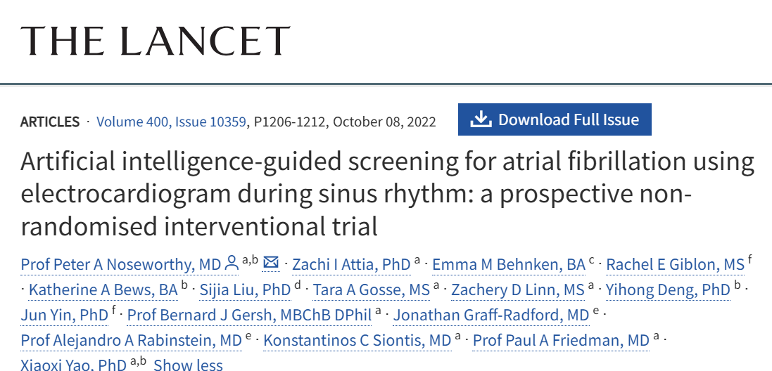
Atrial Fibrillation
Tripled the detection of AF over 10 months
10.6% vs. 3.6%
Notes:
We included 180 922 patients with 649 931 normal sinus rhythm ECGs for analysis: 454 789 ECGs recorded from 126 526 patients in the training dataset, 64 340 ECGs from 18 116 patients in the internal validation dataset, and 130 802 ECGs from 36 280 patients in the testing dataset. 3051 (8·4%) patients in the testing dataset had verified atrial fibrillation before the normal sinus rhythm ECG tested by the model. A single AI-enabled ECG identified atrial fibrillation with an AUC of 0·87 (95% CI 0·86–0·88), sensitivity of 79·0% (77·5–80·4), specificity of 79·5% (79·0–79·9), F1 score of 39·2% (38·1–40·3), and overall accuracy of 79·4% (79·0–79·9).
1003 patients (adults underwent ECG at any Mayo clinic site, no Afib, elevated CV risk that would merit anticoagulation). with a mean age of 74 years (SD 8·8) from 40 US states completed the study. Over a mean 22·3 days of continuous monitoring, atrial fibrillation was detected in six (1·6%) of 370 patients with low risk and 48 (7·6%) of 633 with high risk (odds ratio 4·98, 95% CI 2·11–11·75, p=0·0002). Compared with usual care, AI-guided screening was associated with increased detection of atrial fibrillation (high-risk group: 3·6% [95% CI 2·3–5·4] with usual care vs 10·6% [8·3–13·2] with AI-guided screening, p<0·0001; low-risk group: 0·9% vs 2·4%, p=0·12) over a median follow-up of 9·9 months (IQR 7·1–11·0).
-2/3 of patients flagged as high risk by algorithm

Slide 31

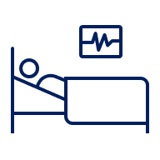


Delirium is a leading cause of hospital harm
Delirium affects 20-30% of hospitalized adults
Delirium is distressing for patients, caregivers and providers and is associated with worse outcomes and greater cost
8 days
Longer average hospital stay
2.0X
Increased mortality
2.4X
Increased placement in nursing home
$10,899
Increased average cost per hospitalization

Slide 32
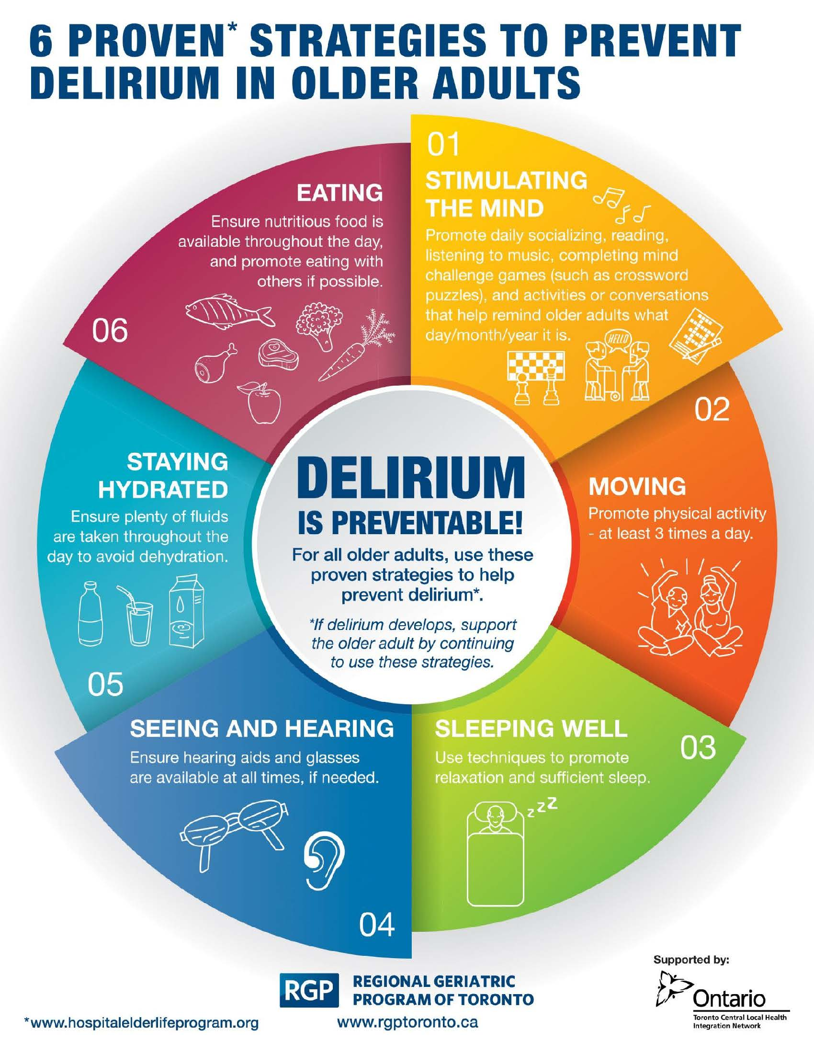
Delirium is preventable
14 Randomized Trials have shown that multicomponent interventions can reduce delirium incidence by ~40% compared to usual care
But, these interventions are labour-intensive and are not implemented well

Slide 33


Change Idea: Use AI to focus prevention efforts
Delirium Risk
Score
Hospital Data
Prediction Tool
Medical history
High
Laboratory
Medium
Low
Demographics
Implement delirium prevention bundle in high-risk patients
Notes:
Phase in
Can be used anywhere in the hospital

Slide 34

Identifying & Predicting Delirium
We created a model to predict delirium risk at the time a patient is admitted to hospital with ~75% accuracy, with just ~10 inputs
Chart review^{1,2} in ~10,000 patients
1. Wang et al. AMIA Jt Summits Transl Sci Proc 2022 PMID: 35854747; 2. Inouye et al., JAGS 2005 PMID:15673358

Slide 35
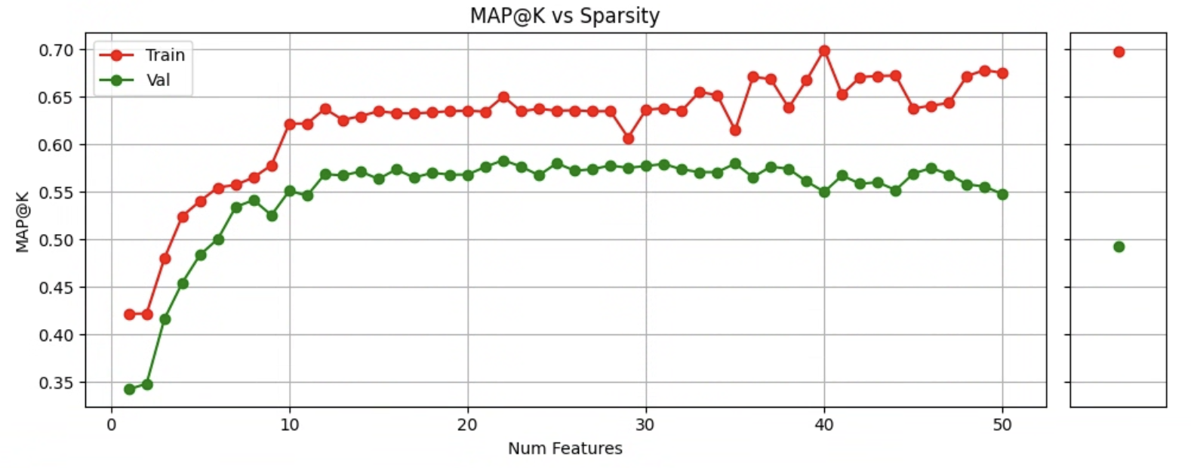
Sparsity Analysis
AP@K vs Sparsity
AP@K
Plateau 1: 7 to 11 features
Plateau 2: 12 or more features

Slide 36
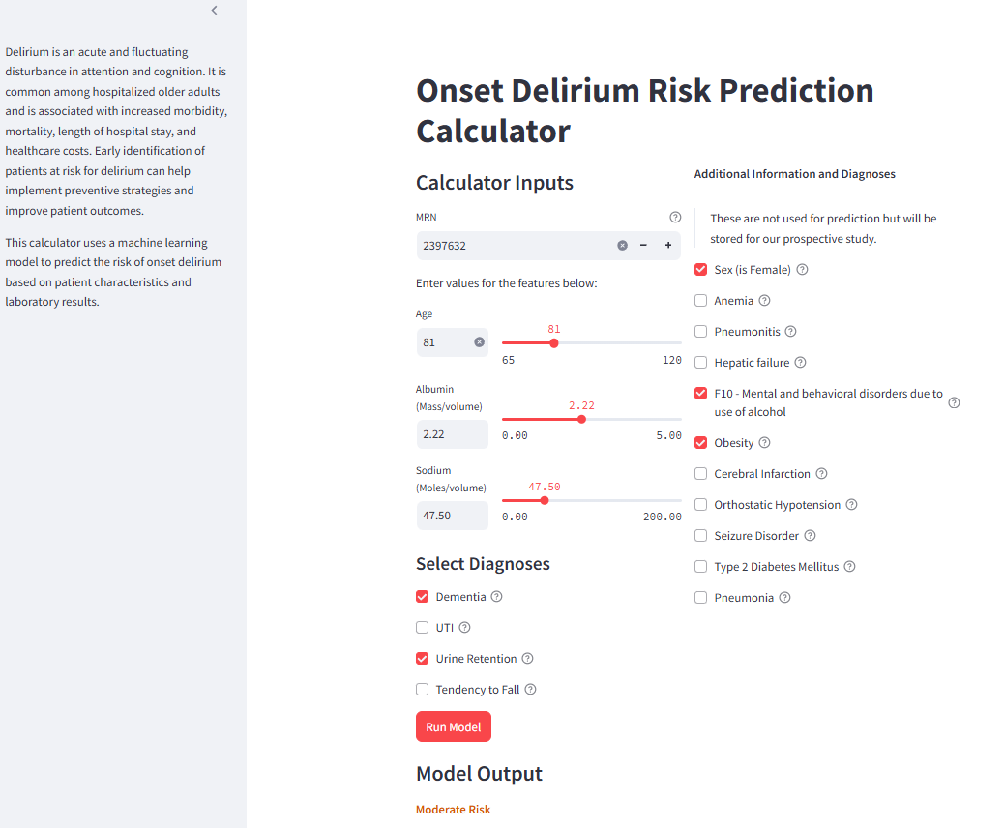

Slide 37


“AIM to Prevent” Delirium RCT
Using GEMINI we are studying the intervention in ~15,000 patients
The largest RCT of clinical AI in Canada, one of the largest in the world
Completed in 18 months
6 Hospitals Intervention
All 12 Hospitals Intervention
6 months
12 months
All 12 Hospitals No Intervention
6 Hospitals No Intervention

Slide 38
What can we expect AI to accomplish in the next 3 years?
Act like clinicians – information processing and document generation at least at level of a competent trainee
Complement clinicians – decision support
Do things clinicians can’t – complex pattern recognition and prediction

Slide 39


What is the evidence base for real-world clinical use of AI?
Out of 519 clinical studies of LLMs, between 2022-2024, only 5% used real patient data

Slide 40
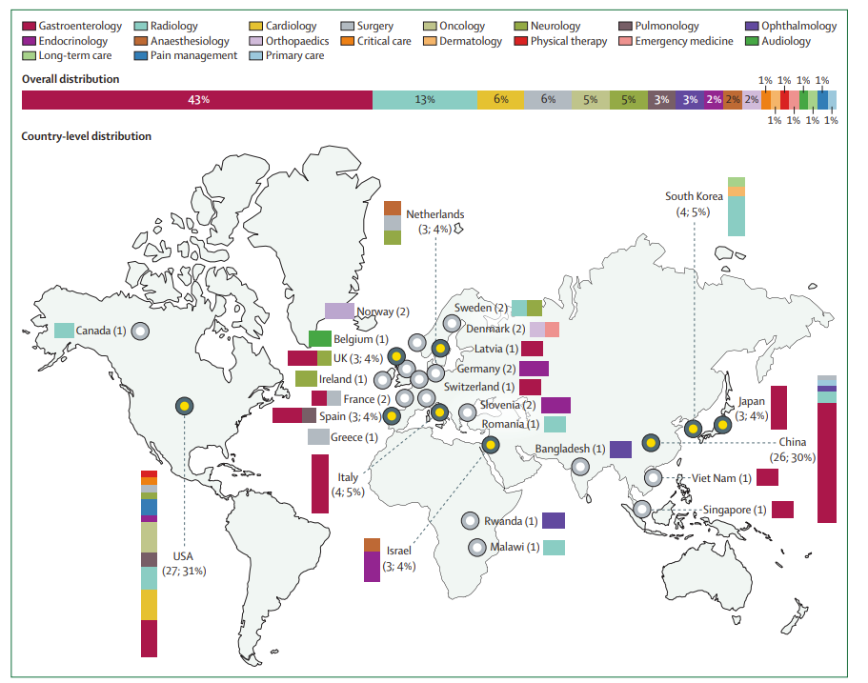
What is the evidence base for real-world clinical use of AI?
Out of 519 clinical studies of LLMs, between 2022-2024, only 5% used real patient data
Between 2018-2023, ~ 100,000 RCTs of medications

Slide 41
What is the evidence base for real-world clinical use of AI?
Out of 519 clinical studies of LLMs, between 2022-2024, only 5% used real patient data
Between 2018-2023, ~ 100,000 RCTs of medications, and only 86 RCTs of AI interventions, only 1 in Canada

Slide 42
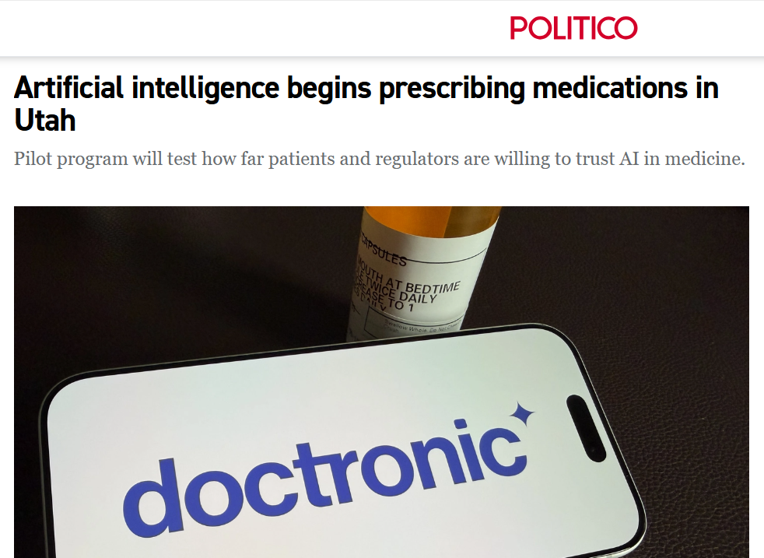
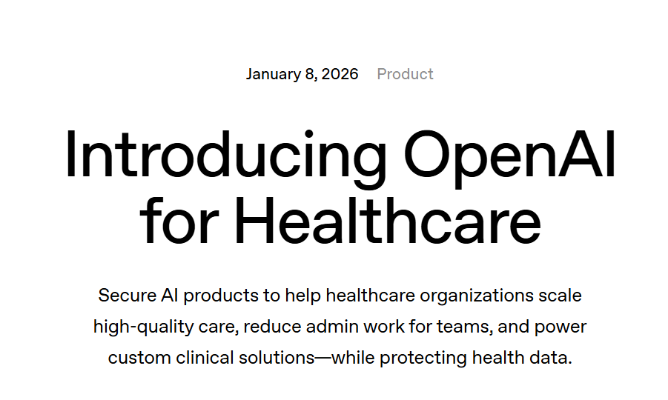
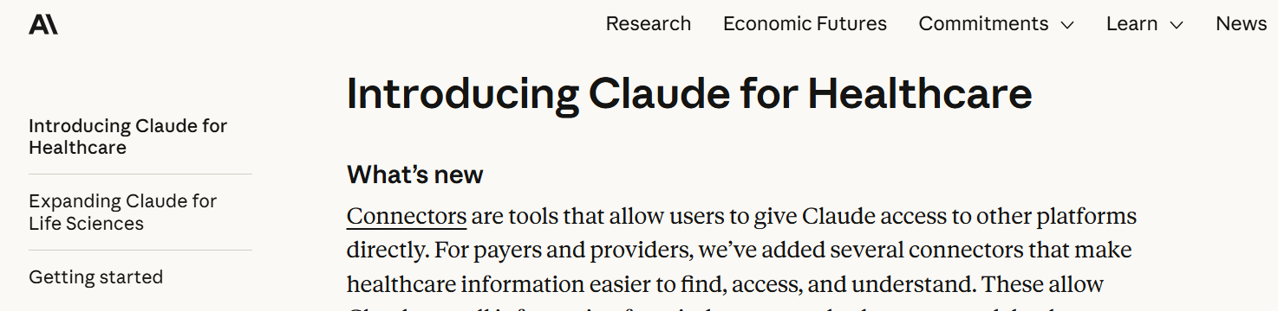
AI is at a “tipping point” in U.S. healthcare

Slide 43
U.S. Healthcare is NOT the same as Canadian Healthcare
Not inclusive:
27M Americans without insurance
More expensive:
$12,555 USD per capita vs $6,319
More intensive:
34% more likely to get outpatient antibiotic
56% more likely to get an MRI
57% more likely to get invasive cardiac procedure
471% more likely to get an amputation in diabetes
Notes:
https://aspe.hhs.gov/sites/default/files/documents/ee0475e44e27daef00155e95a24fd023/nhis-q1-2024-datapoint.pdf
Health at a Glance 2023 (EN)
Trends in Use of Medical Imaging in US Health Care Systems and in Ontario, Canada, 2000-2016 | Radiology | JAMA | JAMA Network
Untitled
https://hsrlce.utoronto.ca/wp-content/uploads/2015/03/Prevalence-and-Extent-of-Obstructive-Coronary-Artery-Disease-Among-Patients-Undergoing-Elective-Coronary-Catheterization-in-New-York-State-and-Ontario.pdf

Slide 44

U.S. Healthcare is NOT the same as Canadian Healthcare
Not inclusive:
27M Americans without insurance
More expensive:
$12,555 USD per capita vs $6,319
More intensive:
34% more likely to get outpatient antibiotic
56% more likely to get an MRI
57% more likely to get invasive cardiac procedure
471% more likely to get an amputation in diabetes
This is bad training data for AI for Canadian healthcare
Notes:
https://aspe.hhs.gov/sites/default/files/documents/ee0475e44e27daef00155e95a24fd023/nhis-q1-2024-datapoint.pdf
Health at a Glance 2023 (EN)
Trends in Use of Medical Imaging in US Health Care Systems and in Ontario, Canada, 2000-2016 | Radiology | JAMA | JAMA Network
Untitled
https://hsrlce.utoronto.ca/wp-content/uploads/2015/03/Prevalence-and-Extent-of-Obstructive-Coronary-Artery-Disease-Among-Patients-Undergoing-Elective-Coronary-Catheterization-in-New-York-State-and-Ontario.pdf

Slide 45
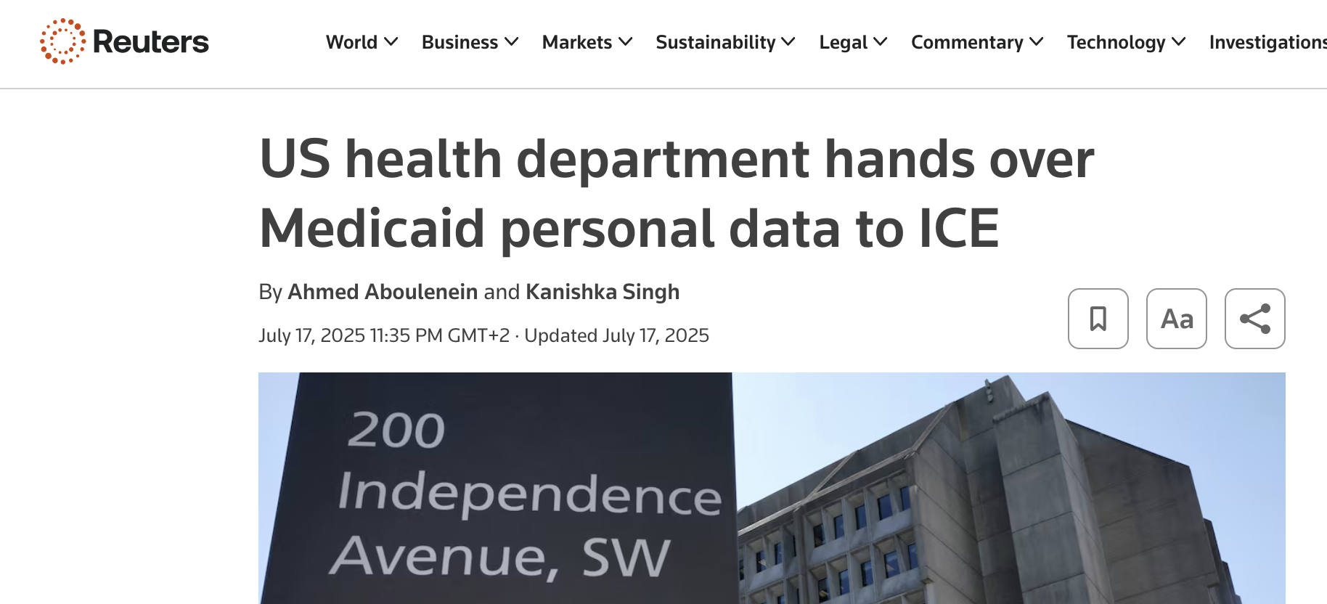


Data Sovereignty Without a flourishing Canadian ecosystem for health data innovation, we cede control of these technologies and our sensitive health data to other countries.

Slide 46
How do we develop and test clinical AI?
Data
Infrastructure
People
Notes:
GEMINI is among Canada’s largest hospital data and analytics networks, one of the largest in the world. We collect electronic clinical data (extracted from hospital information systems) and administrative data from 30 hospitals across all regions of Ontario, who care for about 60% of the province’s patients. The data are collected for all medical (ie. general medicine and medical specialties like cardiology, oncology, etc.) and intensive care admissions. GEMINI data currently contain more than 1.6 million hospitalizations.
The data are collected at St. Michael’s Hospital and made available to a large community of students and scientists in the HPC4Health data platform, a secure high-performance computing cloud based at SickKids.

Slide 47

Data
Infrastructure
People
Notes:
GEMINI is among Canada’s largest hospital data and analytics networks, one of the largest in the world. We collect electronic clinical data (extracted from hospital information systems) and administrative data from 30 hospitals across all regions of Ontario, who care for about 60% of the province’s patients. The data are collected for all medical (ie. general medicine and medical specialties like cardiology, oncology, etc.) and intensive care admissions. GEMINI data currently contain more than 1.6 million hospitalizations.
The data are collected at St. Michael’s Hospital and made available to a large community of students and scientists in the HPC4Health data platform, a secure high-performance computing cloud based at SickKids.

Slide 48





Electronic data
~40 hospitals
>60% of Ontario’s adult & paediatric patients
>2.4M hospitalizations
Data
Infrastructure
People
Notes:
GEMINI is among Canada’s largest hospital data and analytics networks, one of the largest in the world. We collect electronic clinical data (extracted from hospital information systems) and administrative data from 30 hospitals across all regions of Ontario, who care for about 60% of the province’s patients. The data are collected for all medical (ie. general medicine and medical specialties like cardiology, oncology, etc.) and intensive care admissions. GEMINI data currently contain more than 1.6 million hospitalizations.
The data are collected at St. Michael’s Hospital and made available to a large community of students and scientists in the HPC4Health data platform, a secure high-performance computing cloud based at SickKids.

Slide 49

Electronic data
~40 hospitals
>60% of Ontario’s adult & paediatric patients
>2.4M hospitalizations
High performance computing environment
Research software and supporting materials
Data
Infrastructure
People
Notes:
GEMINI is among Canada’s largest hospital data and analytics networks, one of the largest in the world. We collect electronic clinical data (extracted from hospital information systems) and administrative data from 30 hospitals across all regions of Ontario, who care for about 60% of the province’s patients. The data are collected for all medical (ie. general medicine and medical specialties like cardiology, oncology, etc.) and intensive care admissions. GEMINI data currently contain more than 1.6 million hospitalizations.
The data are collected at St. Michael’s Hospital and made available to a large community of students and scientists in the HPC4Health data platform, a secure high-performance computing cloud based at SickKids.

Slide 50


Electronic data
~40 hospitals
>60% of Ontario’s adult & paediatric patients
>2.4M hospitalizations
High performance computing environment
Research software and supporting materials
>1000 scientists, students, clinicians
>100 active projects
> $210 million grants at >20 institutions
Data
Infrastructure
People
Notes:
GEMINI is among Canada’s largest hospital data and analytics networks, one of the largest in the world. We collect electronic clinical data (extracted from hospital information systems) and administrative data from 30 hospitals across all regions of Ontario, who care for about 60% of the province’s patients. The data are collected for all medical (ie. general medicine and medical specialties like cardiology, oncology, etc.) and intensive care admissions. GEMINI data currently contain more than 1.6 million hospitalizations.
The data are collected at St. Michael’s Hospital and made available to a large community of students and scientists in the HPC4Health data platform, a secure high-performance computing cloud based at SickKids.

Slide 51
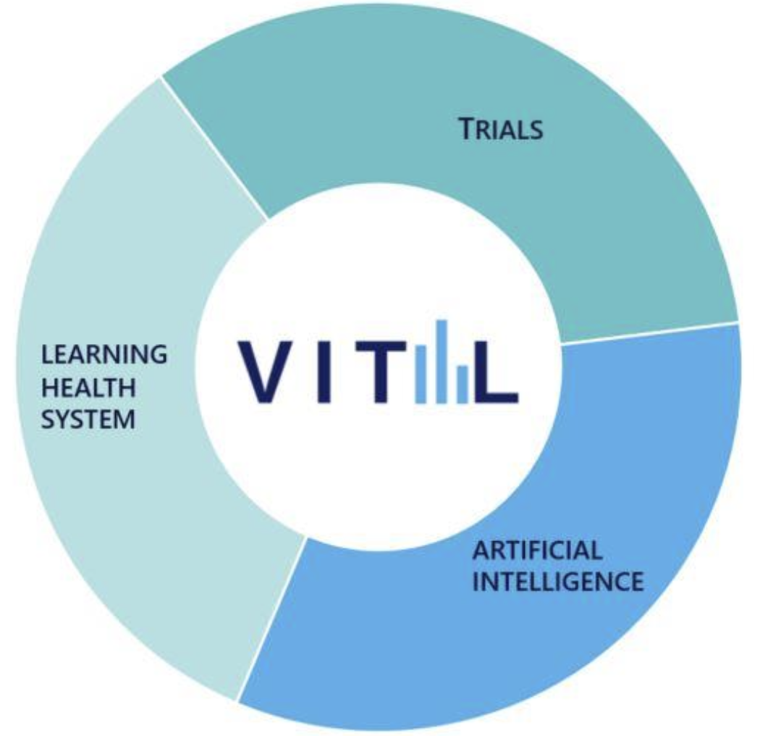
VITAL Data Platform
Near real-time hospital data for 20 million Canadians for research & innovation

Slide 52
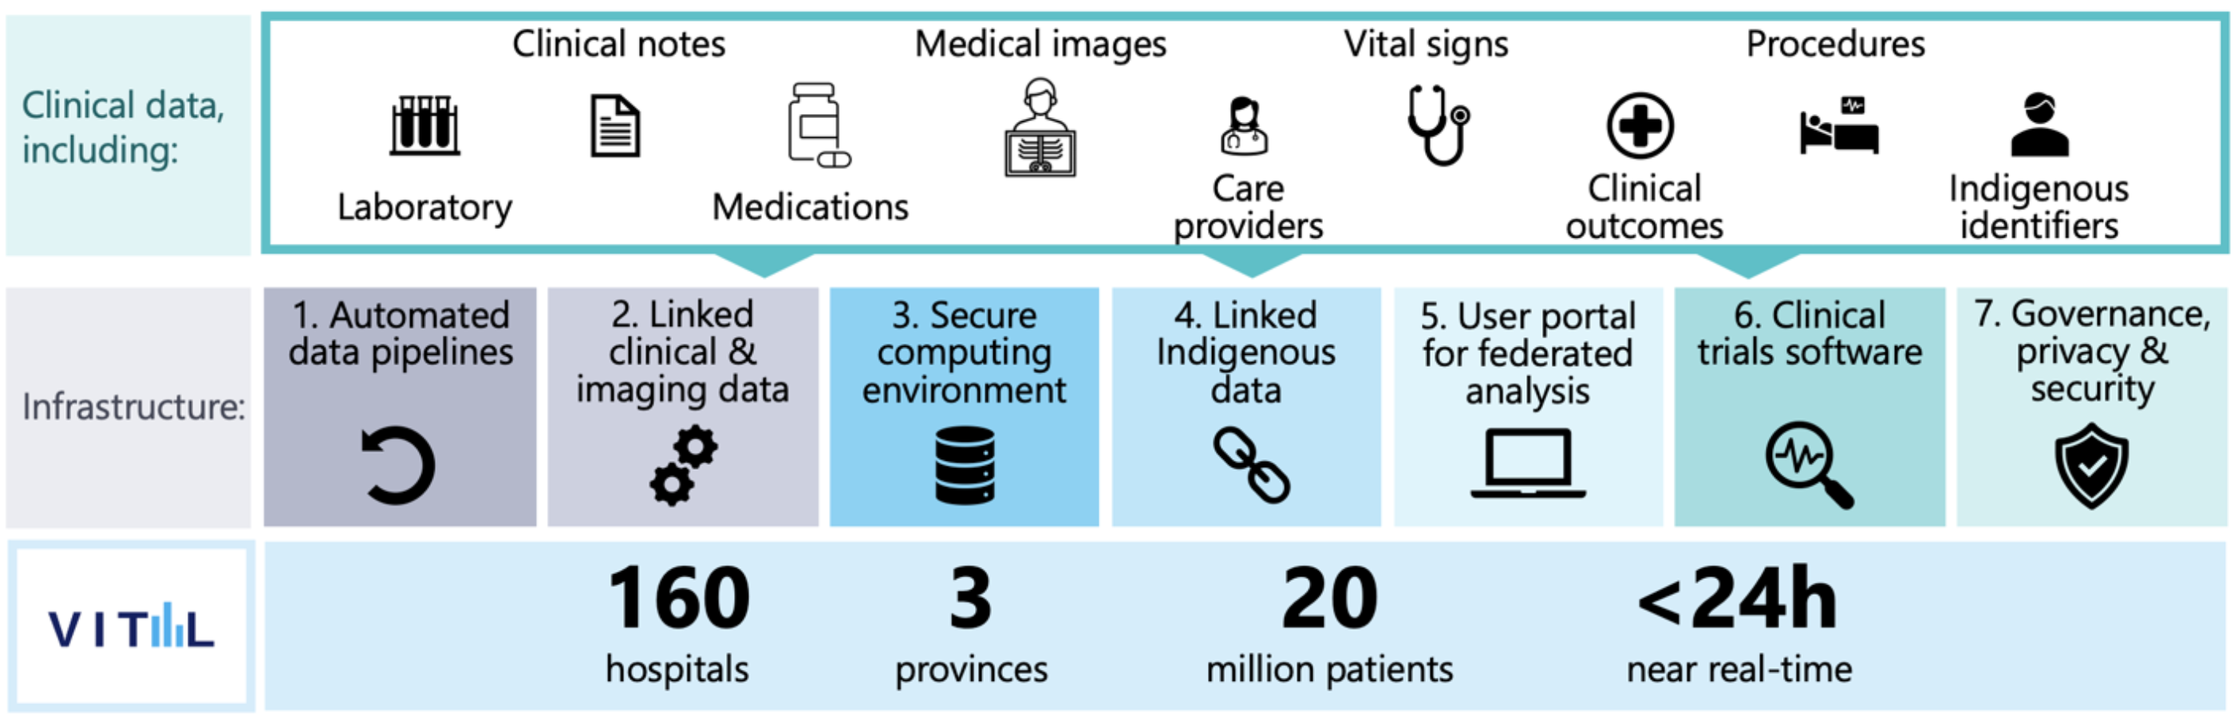
VITAL Data Platform
Near real-time hospital data for 20 million Canadians for research & innovation
Received initial $30M investment from Government of Canada to build on GEMINI, link across Ontario, Alberta, and Quebec.

